Slide 1
CRITERION REFERENCED ASSESSMENT

Slide 2
Learning outcomes
By the end of this session, you should be in position to;
Explain Criterion Referenced Assessment
Appreciate the use of a criterion in assessment
Generate a criterion for a given task

Slide 3
Setting standards
STORY ABOUT A PLANE
When you are young, you dream about planes.
An aeroplane is sometimes called an air plane.
There are many seats on the plane.
Did you know that only 5% of the world population have ever been on an air plane
Air plane symbolizes a portion of many peoples life
People use planes to travel to many places

Slide 4
ACTIVITY 1
In your groups, find ways of representing a plane
What key things/components would you expect on the representation of a plane?
Represent the plane on a clean page/flip chart sheet
Share in plenary

Slide 5
Checking our work against what was agreed
How many of the expected components are on the representation of the plane?
How competent/proficient was the representation?
In competency you are either
- competent / not competent
- proficient/not proficient
There is room to fail
There is room not to attain
There is room to improve the standard

Slide 6
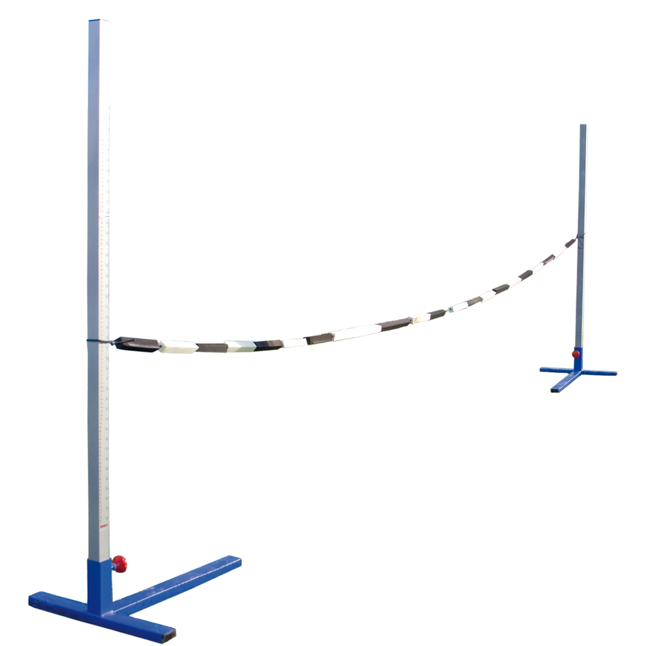
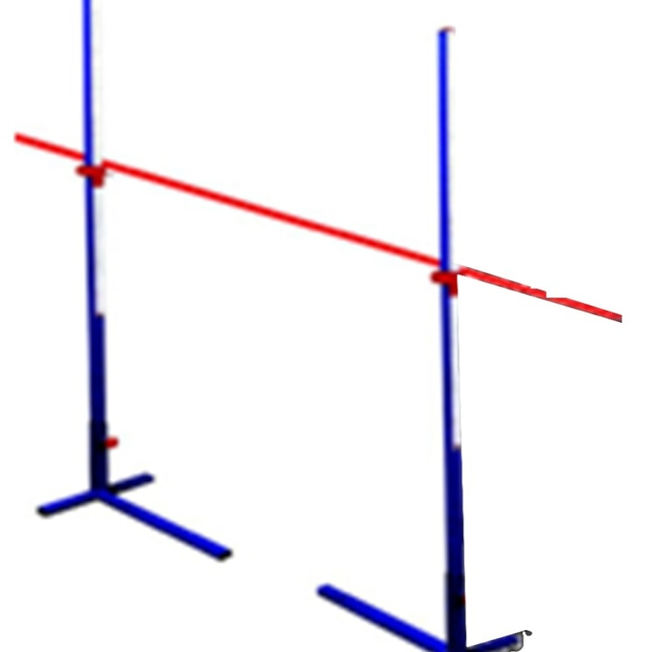
Which of these would you take to be a standard and why?
A
B

Slide 7
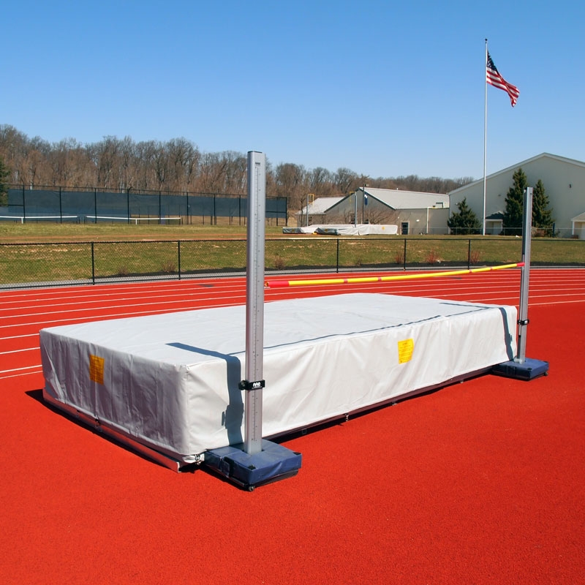
Being competent/proficient/with mastery
Proficiency refers to demonstrating the required level of performance toward an established benchmark/standard.
Proficiency: You have it, or you don’t

Slide 8
ACTIVITY 2
In your groups,
Consult the syllabus book and select a topic of your choice
Suggest a learner activity for criterion referenced assessment
Form a criterion to be followed while assessing the activity
Share in plenary

Slide 9
ACTIVITY 3
In groups,
Prepare a poster inviting people to listen to speakers on how to be safe from the dangers of covid 19
What will you expect to be on a poster for informing people about covid 19?
Present in plenary

Slide 10
Descriptors in competency based education
Human judgment, including decisions about priorities based on values, are necessary elements in the formation of descriptors.
What is a descriptor?
When are descriptors used?
Descriptors are carefully defined levels of progression that allow reliable interpretation and maintain consistency.
They describe performance or what can be done

Slide 11
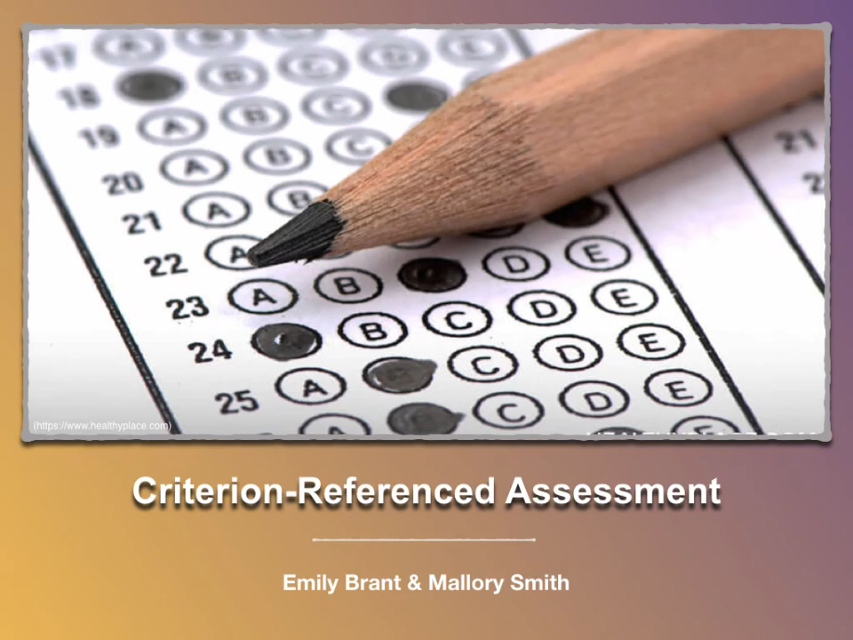
Watch the video and take note of key aspects of criterion referenced assessment (13 minutes)

Slide 12
What lessons do you draw from the video?
(General discussion)

Slide 13
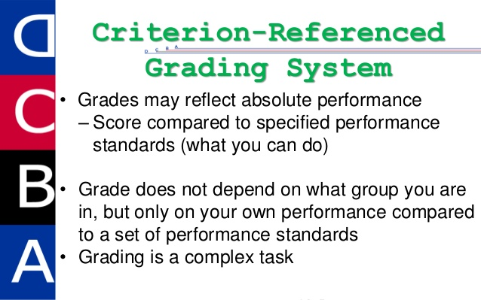

Slide 14
Criterion Referencing and Grade Descriptions
Criterion referenced tests and assessments are designed to measure the learner performance against a fixed set of predetermined criteria or learning standards
OR The concise written descriptions of what the learner is expected to know and be able to do at a specific stage of his or her education.
Criterion referenced assessments are used to evaluate whether the learner has learned a specific body of knowledge to do something in real life or acquired a specific set of skills needed.

Slide 15


Slide 16
Thanks for your active participation

